Slide 1
Librarians as Partners in Bringing your Research to Publication
Jessica G. Bell, MS
Director of the Library and Learning Experience Design
Notes:
Thank you, Inge for that warm introduction.
Hello, everyone, and thank you for coming. I am here to talk with you about how librarians can help in the research process.
As you might expect, I will mostly focus on those parts of the research process that involve information finding and use, and every consultation type I will be describing will not be for everyone. Depending on your own expertise and where you are professionally, you may seek to engage with a librarian more or less on any of the services I will describe.

Slide 2
What Librarians Bring to the Table
We like to help
Lots of questions
Referrals
Note: From Our waitress June serves deep fried soft-shell crab @ Baan Krua Thai Restaurant, by Vanessa Pike-Russell, 2007, Flickr (https://www.flickr.com/photos/lilcrabbygal/403464687). CC BY-NC-ND 2.0.
Notes:
Before diving into the details, I want to start with some general observations of what librarians can bring to the table.
Helping profession
Good at asking questions – we are actually taught to ask questions as part of librarian education
Bring new light to a topic (clarifying and crystalizing)
We ask different questions than most other people, because we tend to think about things through a lens of how we might find information
How are people communicating about a topic?
Who are the people who are communicating about a topic?
Where are those communications happening?
Referrals - librarians work with a lot of people, usually know where to go for other services, possible collaborators

Slide 3
Background
Q.I. Project
Interviewed 32 scholars
Asking
How they used the library’s services
What other help they needed
Note: From Brick wall, by Page DeWolfe, 2017, Flickr (https://www.flickr.com/photos/triviaqueen/33886387122). CC BY 2.0.
Notes:
The specific functions that librarians can help with that I’m about to talk about came out of a quality improvement project we conducted at the Bellack Library where we interviewed 32 scholars at MGH Institute of Health Professions and asked them how they had used the library’s services and what other help they could have used.
We really wanted to get to know where people had experienced barriers and stumbling blocks, where they turned for help, and the resources that helped them be successful in gathering and presenting information.
Based on our small, site-specific sample, I realize the results we have are not generalizable, but they certainly seem universal. Nothing really earth shattering came from our data. What the results showed us were ways we could communicate with people about how the library can contribute.

Slide 4
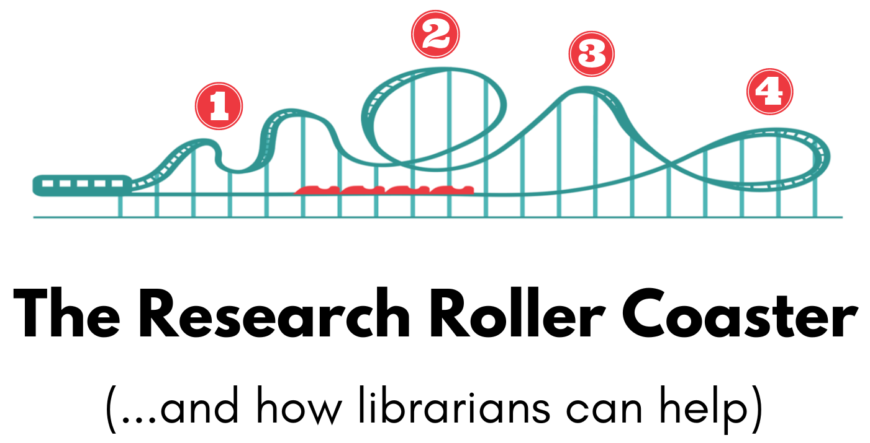
Notes:
What resulted was something we called the Research Roller Coaster (and how librarians can help).
The roller coaster metaphor came out of all of the emotional ups and downs people described during our interviews.
It also represented the repetitive nature that literature searching can bring, and you’ll soon see that’s why number 2 is situated above the loop-de-loop.
We found 4 distinct themes that translated into areas where librarians could contribute.

Slide 5
Developing a question
1
Literature Searching
2
Organizing
3
4
Publishing

Slide 6
Developing a question
1
Scope
Available evidence
Research methods
Background data
Notes:
The first area, Developing a Question, had four subtopics within it.

Slide 7
Developing a question
1
Scope
Note: From Scopes, by John Loo, 2011, Flickr (https://www.flickr.com/photos/johnloo/5974097391). CC BY 2.0.
Notes:
First up, Scope.
When you are developing a question, it is really important that you select an appropriate scope for that question, and depending on how much you know about the topic, that can be challenging.
…and it is related to the next area within the Developing a Question topic,

Slide 8
Developing a question
1
Situated in the available evidence
Note: From Fingerprint, by Conall, 2017, Flickr (https://www.flickr.com/photos/conall/34381472845). CC BY 2.0.
Notes:
Your question needs to be situated in the available evidence.
Knowing what research has come before lets you create a space for your own research with a scope and focus that make sense to the discipline.
Does your area have very little research, well then the scope of your question may need to be broad and more inclusive? If your area has quite a bit of established evidence, then you can really narrow in to identify the niches that haven’t been explored yet. Think a big sprawling epic vs a character study. War and Peace vs The Catcher in the Rye, or perhaps something in between.
In fact, many of my conversations about scope and evidence with researchers often revolve around finding the sweet spot between finding something they care deeply about (necessary for maintaining motivation through the long hours) and something that moves the discipline forward. During the course of these conversations, we will often plan a trajectory of research projects that build on each other to ultimately answer the question that started the inspiration.
Another conversation I often have with novice researchers is when they have discovered that their topic is one that is almost completely novel to their discipline and the panic sets it, “but what do I cite in my literature review?” Those conversations often involve breaking the topic down into component parts, finding literature about those parts, and then structuring the literature review section of the paper to pull them all together. Or it may involve looking at other disciplines to see if they can cite literature that is parallel but just outside the usual realm.
A librarian can help with all of these by diving into the literature and looking at what already exists.

Slide 9
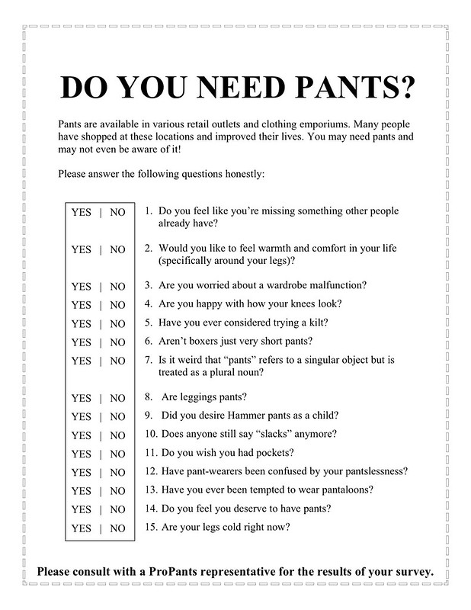
Developing a question
1
Research
design and methods
Note: From Do you need pants? Questionnaire, by Jason Eppink, Flickr (https://www.flickr.com/photos/jasoneppink/3190318778). CC BY 2.0.
Notes:
Most people come to a librarian with their research method already selected, but occasionally people come to me early in the process with ideas of what they want to do, but not quite settled on how they’re going to do it.
Most frequently it is when there is something novel or unusual about the research design, and the researcher wants to be able to cite previous work that used similar methods or perhaps cite a theoretical framework that helps support the decision to use a particular design.
For example, I just met with one of our PhD students who was going to be using a mixed methods approach where the qualitative and quantitative data would be collected simultaneously and used to explicate a theoretical model. We found a few studies using a convergent parallel model for data collection, but realized they weren’t giving her the information she needed. Through the course of our conversation, she ultimately realized that the place where she could use more guidance was in the area of applying the collected data to the theoretical model. So we changed course and looked for studies that tested models and concepts.
As is so often the case with the conversations I have with researchers. The information she thought she needed coming into the meeting was not at all what she wound up finding the most useful by the end of the conversation. The conversation was a necessary part of the process.

Slide 10
Developing a question
1
Background Data
Note: From Rollercoaster graph, by ggstopflat, 2011, Flickr (https://www.flickr.com/photos/21622267@N03/5846337367). CC BY-NC 2.0.
Notes:
This is all of that information that can help you establish the problem you are examining or attempting to solve. Although this seems really straightforward, data can be tricky. It is often hidden in lengthy government reports or buried in a table in a published paper. Finding these bits and pieces often involves going back to that thinking about “who cares about this data?” “In what context would someone need this data?” “Who might be responsible for collecting this data?”
Somewhat related to background data, librarians can also help you clear up your operational definitions (mostly because we ask so many darn questions) and find citations to back up those decisions if necessary.
Now let’s move onto the second area…

Slide 11
Literature Searching
2
Selecting databases
Identifying terms
Search strategy
Database tools
Notes:
This is the one that everyone thinks of when they think of librarians, and for good reason. This is a major way we can contribute to your research process.
So let’s break it down a bit, for those who haven’t worked with a librarian before, and there are these 4 main areas within the Searching category (read them).
Another thing to know is that, depending upon your library, there may be a range of possibilities for how you interact with a librarian in the search process. If you’d like the librarian to deliver a fully formed search to your inbox, then you may simply need a brief meeting to get some of those many questions answered before the librarian launches into the search.
However, if you would like to be involved in the search, you can do that too. You and your librarian can meet and walk through all of these steps, creating a search together. This can be especially helpful for those of you who have less experience with literature searching, because you can learn so much about your topic along the way.

Slide 12
Literature Searching
2
Selecting Databases
Notes:
For many people selecting which databases to search for literature is very straightforward. In the health sciences it almost always involves PubMed or Medline and often CINAHL too.
What librarians can help you do is identify databases that are outside the health sciences. If you have a topic that has multidisciplinary aspects (developmental disorders or community health topics, possibly), you could be well served by dipping into databases from other disciplines like APA’s PsycInfo or Sociological Abstracts, or ERIC). You might discover pockets of relevant literature you had no idea existed.

Slide 13
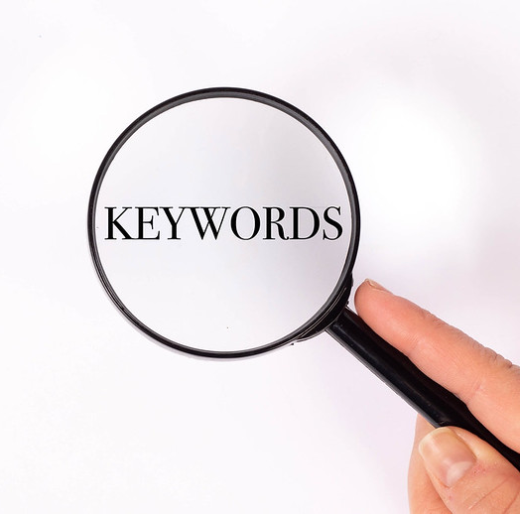
Literature Searching
2
Identifying Search Terms
Note: From Keywords under magnifying glass, by Marco Verch Professional Photographer, Flickr (https://www.flickr.com/photos/30478819@N08/46050576102). CC BY 2.0.
Notes:
Almost always more challenging than you think it should be, especially if you are trying to get anything close to a comprehensive picture of the literature on a topic.
So often when people begin searching a topic, they see-saw between too many and too few results. It feels like you can go from a results list of 5 articles to 2 million in PubMed quite easily. What searching really involves is making decisions about the scope of your question and what’s included and probably even more importantly, what’s not.
Librarians can help you find the combination of terms that will get you a useful and relevant set of results.
To get there usually involves lots of brainstorming, looking at other sources to mine them for vocabulary, and examining the subject headings created by the databases., Think Medline’s MeSH (Medical Subject Headings).
For those who aren’t familiar with subject headings, those are systems of controlled vocabulary created by the databases so that there are consistent ways to refer to subjects and topics. The classic example is for hypertension. If you know that the database uses the subject heading “hypertension” then you don’t need to search for “high blook pressure” as well. You’ll know that even if an author uses “high blood pressure” the database will still tag that article with the subject heading “hypertension.” It can mean less guess work for you as a searcher, because you don’t have to predict the enormous variety of ways authors might refer to topics. You simply need to know the way the database refers to topics.
Subject headings can be tricky, but its an area librarians know well.

Slide 14
Literature Searching
2
AND
OR
Search strategy
“Phrase searching”
Notes:
Once you have your search terms, then you need to put them together into a search strategy.
So that includes all of the tools for putting searches together (and, or, truncation, quotation marks, etc.). This is definitely an area where you could take the time to learn all of these search techniques, but why both when you have a librarian who already knows how to use them and is happy to help?
The search strategy also includes evaluating (and most likely revising) your search based on the results you get back after trying it out, which, of course, includes getting specific about your inclusion/exclusion criteria and being clear on what is and isn’t relevant literature.
Having conversations with a librarian about all of these can be very helpful.

Slide 15
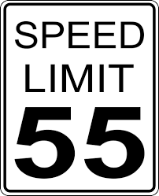
Literature Searching
2
Database Tools
Limits and Filters
Accounts and Alerts
Notes:
We can also help you navigate how to actually use the databases with all of their (sometimes overwhelming number of) features.
These include the limits and filters that can help you narrow your results by selecting publication date ranges, the language of the article, and study population characteristics. I will warn you that not all databases are created equal when it comes to these filters and limits and that there are some hidden rules about how they work.
For example, if you apply any of the filters related to study subjects (age, species, etc), you are automatically limiting your search results to studies. I know that sounds obvious when I say it out loud, but if you would like to see commentaries or analyses that aren’t strictly the results of research, then you should avoid the filters and use keywords to describe your population instead.
Back to more database tools, we can also use those other features like creating accounts, saving searches, and setting up email alerts to let you know when knew content that meets your search criteria has been added to the database.
OK, let’s move on from Searching to the next category…

Slide 16
Organizing
3
Citation Management
Data
Organizing for synthesis
Notes:
Organizing. This is another classic area for librarian help. So let’s talk about what all of this means.

Slide 17
Organizing
3
Citation Management
Notes:
Most libraries subscribe to and/or support one or more citation management tools to help their researchers gather, organize, and format their articles and references. These can be crucial tools to keep your sources at your fingertips and save you time formatting your citations and references.
If you’ve ever had the pleasure of using APA format as you prepare your manuscript only to discover that the journal you want to submit to is from Springer and therefore uses their “unique” style, seen no where else, and have to entirely reformat your citations and references, you will appreciate that changing between styles in one of these tools is a snap. Most of them even have the rules for those “unique” styles journals insist on using.
Either way, whether you are interested in the organization or the formatting or both, before you get started on a major literature search or if you already have piles of pdfs floating around your drives, it’s time to sit down with a librarian and learn to use one of these tools.

Slide 18
Organizing
3
Data organization, management, and synthesis
Notes:
In a step beyond the Zoteros and other software applications for organizing your articles, there are all sorts of data matrices that can help you pull out the relevant information from those articles and keep it all in one place. Depending on how your matrix or table is organized it can help you begin synthesizing the information you’ve found as well.
Librarians are often familiar with these tools and can help you select the one that meets your needs.
As for data management, for this one I am referring to the data you collect in your research. Some libraries have data management librarians who will assist you through the entire research data lifecycle: planning, acquiring, analyzing, and preserving. You’ll want to get to know that person.

Slide 19
A Brief Pause for Thoughts about Systematic and Scoping Reviews
Notes:
Systematic and scoping reviews involve all of the previous knowledge and skills but to the Nth degree.
For those who are not familiar with these methods, the research method involves a comprehensive search of the literature that addresses a particular question or to map the available literature more broadly, in the case of a scoping review.
You will want to work closely with a librarian in all of the stages previously described
Developing a question
Determining that a review does not already exist
Scope becomes very important when you consider the need to extract data from analzye all of articles that meet your criteria
Choosing the right type of review for your question
Literature searching
Selecting all of the databases that contain literature relevant to your subject area
Developing a search that is as inclusive as possible without being entirely overwhelming (see note about needing to actually read and analyze every article that fits your criteria)
Applying filters and limits appropriately
Organizing
Using reference management tools to deal with the large number of articles you’ll be collecting
Employing other tools such as Covidence to keep you organized through the screening process and keeping track of the decision making so that you have clear data to report in your Methods and Results sections
Thinking through data extraction methods.
For all of those reasons, if you are even considering a systematic or scoping review, I highly recommend inviting a librarian onto your team as a co-author right from the start.

Slide 20
Publishing and beyond
4
Journal selection
Promotion
Measuring impact
Notes:
Finally we get to publishing and beyond.

Slide 21
Publishing and beyond
4
Journal selection
Notes:
Finding the right journal for your manuscript is crucial. You will want to pay attention to details about your manuscript such as research design (not every journal accepts every type of research), intended audience, geographic scope, impact, and the length of the manuscript are just a few.
A librarian can help you identify journals that publish articles similar to yours, find who the contact is for letters of inquiry, and review the author instructions with you to make sure your manuscript meets the requirements.
In fact, many people wait until after the manuscript is developed before thinking about this, which can be a mistake and lead to extensive re-writes. Journal selection is something to begin considering as soon as you have a research question and design.

Slide 22
Publishing and beyond
4
Promotion
Note: From Frame fun, by Mark Couvillion, Flickr (https://www.flickr.com/photos/chimchim/2571512108). CC BY-NC-ND 2.0.
Notes:
So now you have your paper published, you need to let the world know. Librarians have been helping people get the word out about their work for a long time.
These days it may involve some social media, an institutional repository, a Google Scholar profile, and ResearchGate, plus any number of other tools.
Librarians can help you choose the right places to promote your research so that potential collaborators, potential employers, and news media can find you and recognize your expertise.
This is something I’ve begun working on in our new faculty orientation to help people get started. I try to get faculty set up with OrcID and Google Scholar right away so that it just becomes part of what they do. I used to encourage people to sign up with Twitter as well, but we’re still in wait-and-see mode on whether academia decides to abandon that platform and move somewhere else. It’s certainly a bit more up in the air these days.

Slide 23
Publishing and beyond
4
Measuring Impact
Notes:
For those of you who are faculty and may need to apply for promotion and tenure, this is one more place librarians can help. Librarians can collect metrics that will help you tell the story of the impact of your work. We can find journal impact factors, citation counts, social media engagement, downloads, etc. These numbers can demonstrate your trajectory and growth as your impact expands.

Slide 24
Conclusion + Questions
Notes:
One thing to note: the services offered by any particular library may vary, based on staffing, budget constraints, and expertise. I encourage you to reach out to the librarians at your institutions and get to know them and their services. You won’t regret it.

